Slide 1


Humic Acid Removal
Investigate humic acid performance in floc/sed model
More at Github-Humic Acid
Malini Balachandran // mvb37@cornell.edu
Kaleigh Soucy // krs258@cornell.edu
Joseph Nocua // jsn74@cornell.edu
Humic Acid | Research | Final Presentation Spring 2021

Slide 2
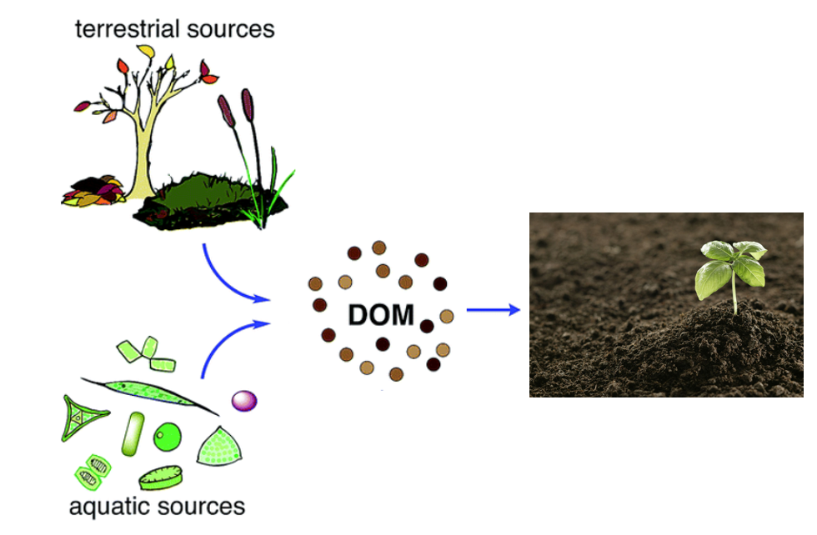
Humic Acid Overview
Natural Organic Matter: Present in surface and groundwater
Humic Acid
1) Color, taste and odor problems
2) Increased coagulant and disinfectant doses needed for removal
3) Biological growth in distribution system
4) Increased levels of complexed heavy metals and adsorbed organic pollutants
5) Increased levels due to climate change and human activity
Reacts with chlorine during chlorination - harmful effects
Figure 1: Diagram of the formation/ life of dissolved organic material
Humic Acid | Research | Final Presentation Spring 2021
Notes:
-Maya
Natural Organic Matter (NOM): Present in surface and groundwater. Within Natural Organic Matter, Dissolved Organic Matter (DOM) is a part of NOM that results from plant and animal decay. Humic acid constitutes a large fraction of DOM. and although they are beneficial to plants because of their stimulation of plant growth and increase of plant disease resistance, they are not beneficial for the drinking water treatment process.
Humic acid has a negative effect on water quality by causing colour, taste and odor problems, increased coagulant and disinfectant doses needed for removal (which in turn results in increased sludge volumes and production of harmful disinfection by-products), biological growth in distribution system, and increased levels of complexed heavy metals and adsorbed organic pollutants.
react with the chlorine to produce trihalomethanes and haloacetic acids, which have carcinogenic effects

Slide 3
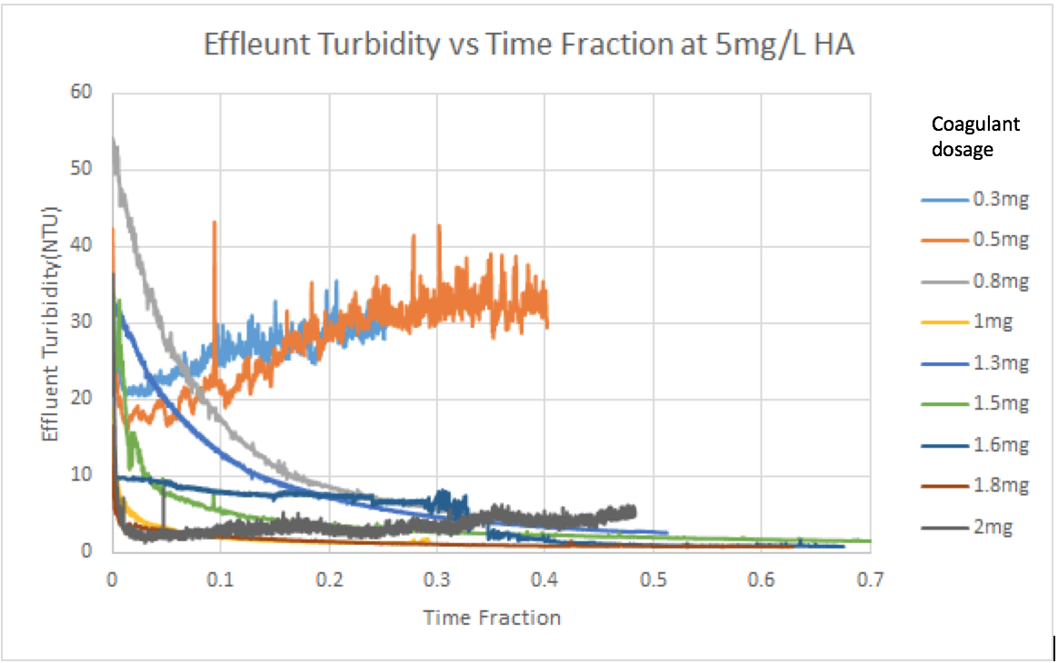
Previous Work
Fall ‘17 and Spring ‘18:
Concentration of Humic Acid (mg/L) | Optimal Coagulant Dosage (mg/L)
5 | 1.6 - 1.8
10 | 1.3
Fall ‘18:
Linear relationships between absorbance and concentration/NTU
Experiments took too long to reach steady state
Figure 5: Absorbance vs. Time Data from Fall’17/ Spring ‘18 for 5 mg/L at various coagulant dosages
Humic Acid | Research | Final Presentation Spring 2021
Notes:
Kaleigh
Last year, the goal was to determine the optimal coagulant dosage for two humic acid concentrations, 5 mg/L and 10mg/L.
After the experiments done with different concentrations of coagulant, the team discovered the optimal dosage for 5 mg/L is 1.6 and for 10mg/L is 1.3 mg/L. The team tried to come up with a mathematical model to calculate the optimal coagulant dosage with known concentration of Humic Acid but the problem was that even with a large change in concentration, the resulting optimal dosage change is small.

Slide 4
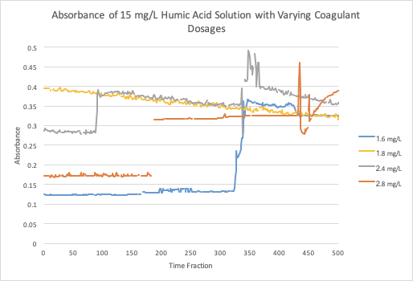
Previous Work
Fall ‘19 and Spring ‘20
Flocs form at slower speed
Small difference in absorbance with smaller and larger concentrations of coagulant
Figure 6: Absorbance vs. Time Data from Fall’19 for 15 mg/L at various coagulant dosages
Humic Acid | Research | Final Presentation Spring 2021
Notes:
Kaleigh
Last semester the focus was on increasing the concentration of humic acid and testing different coagulant dosages at each. The team discovered that at higher coagulant dosages around 2-3 mg/L there was very little change of absorbance recorded which indicates that there’s a limit to how much coagulant can be put in before it becomes ineffective. They were also experimenting with decreasing the amount of Kaolin clay present to see its effect. Additionally, as we were reading the report from the past Humic Acid Subteam, we realized that the measurements for the 10mg/L suggested a strong negative association between coagulant dosage and humic acid concentration. Even though our group believes this relationship to be linear in nature, we believe it to be a strong positive relationship.

Slide 5
Past Challenges
Steady state not defined
ProCoDa communicating with 4 pumps
Running out of Humic Acid influent
Removing Humic Acid without/ with small amounts of Kaolin Clay
Humic Acid | Research | Final Presentation Spring 2021
Notes:
Complications: Kaleigh

Slide 6
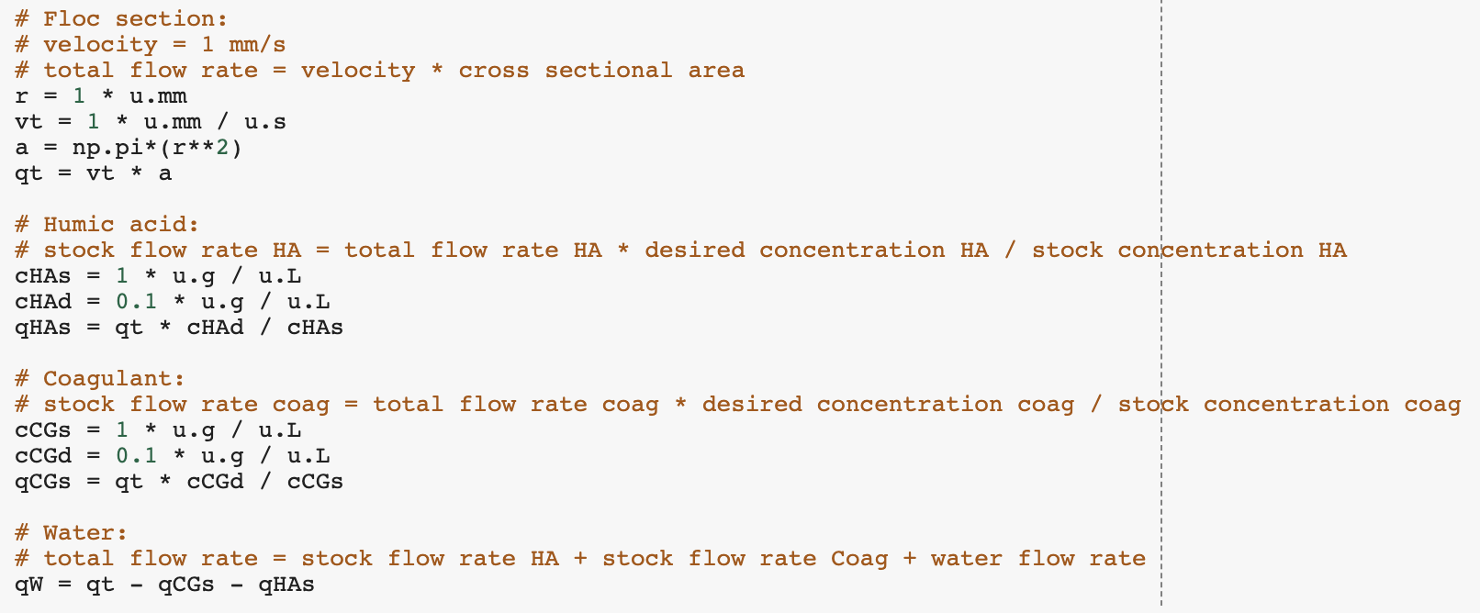
Python Code
Q_{i}C_{i}=Q_{o}C_{o}
where Q is the flow rate and C is the concentration of humic acid/coagulant
Figure 4: Image of python code used in calculating flow rates and concentrations for experimentation
Humic Acid | Research | Final Presentation Spring 2021
Notes:
Kaleigh-
past semesters python code
calculate the flow rates for each pump based on varying coagulant dosages for 15 mg/L, 20 mg/L, and 25 mg/L of humic acid
Determine a experimental procedure and plan for what the team can do in lab after the experimental setup has been constructed

Slide 7
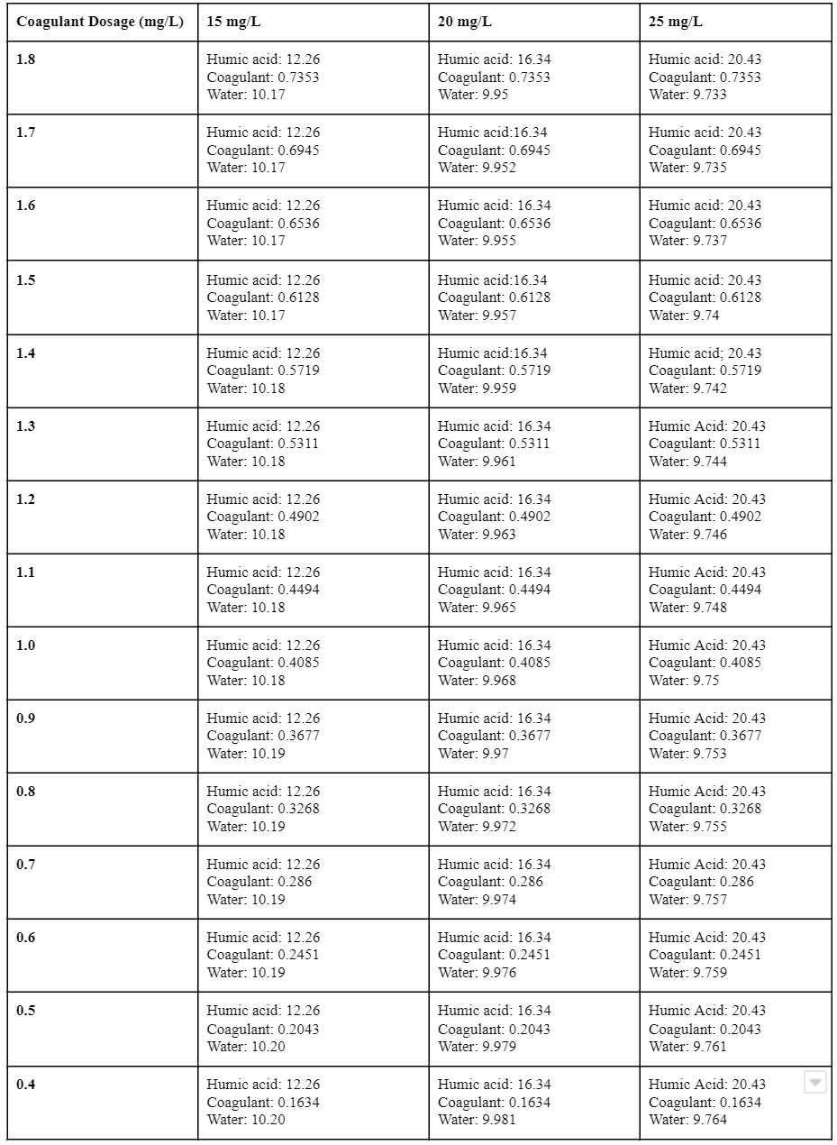
Experimental Procedure
Figures: Table of flow rates in rev/s for each of the experimental setup’s 3 pumps for varying coagulant dosages and 3 humic acid concentrations (15 mg/L, 20 mg/L and 25 mg/L)
Humic Acid | Research | Final Presentation Spring 2021
Notes:
Kaleigh
Table of experimental procedure that was created
Varied coagulant dosages from 0.4-1.8 mg/L to make sure that a good range was covered to find the optimal coagulant dosage for each of the three humic acid concentrations
Past semesters the optimal dosage for 5 and 10 mg/L demonstrated a negative linear relationship which doesn’t follow logically thinking
may need to test higher coagulant dosages as well

Slide 8
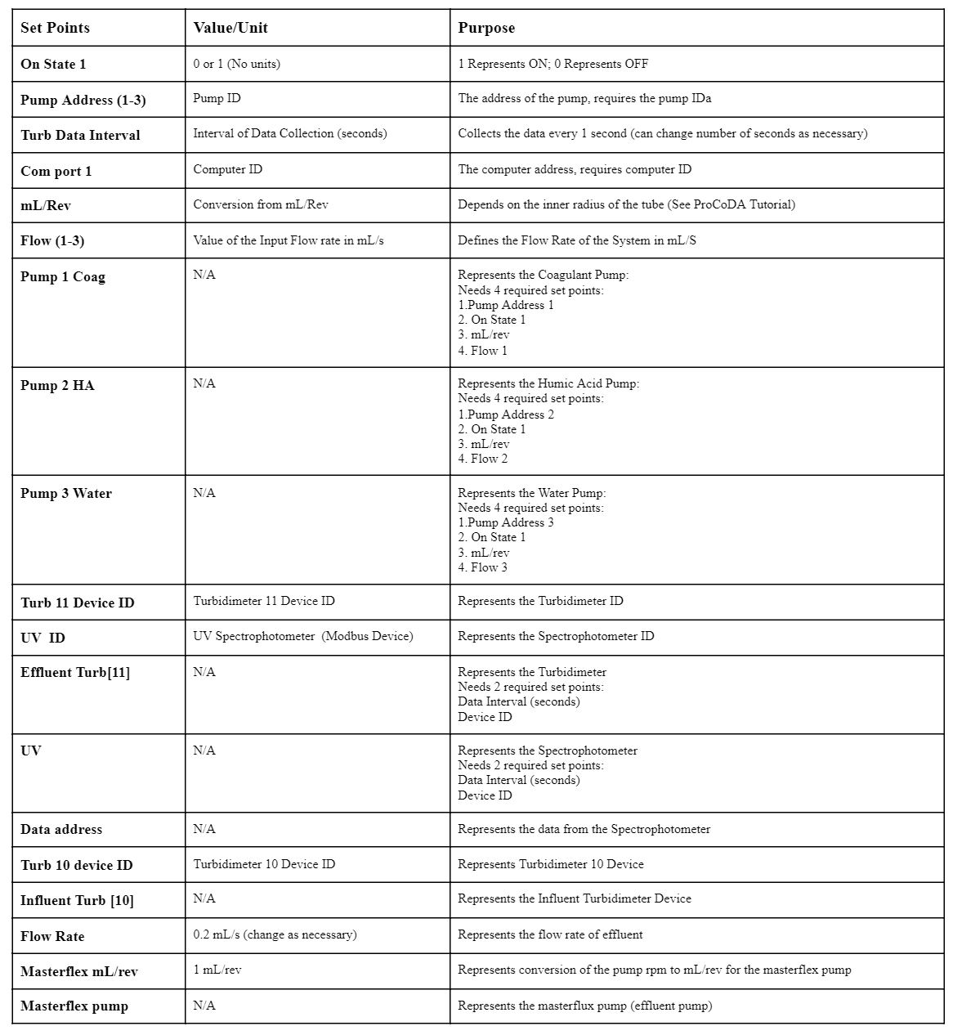
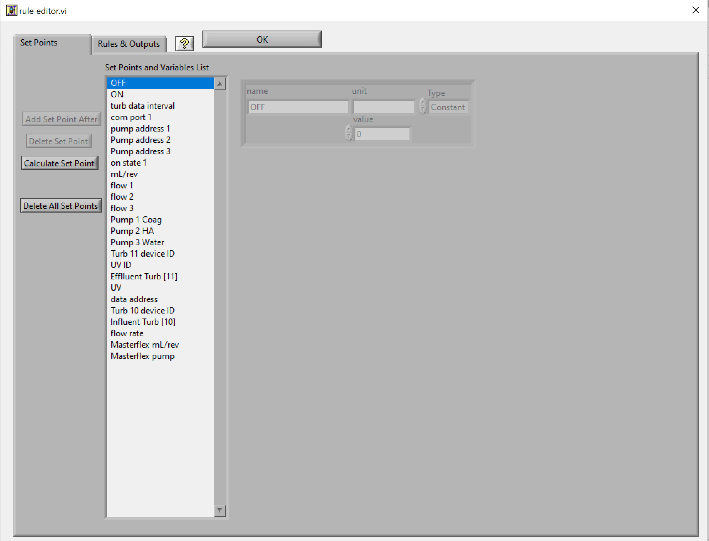
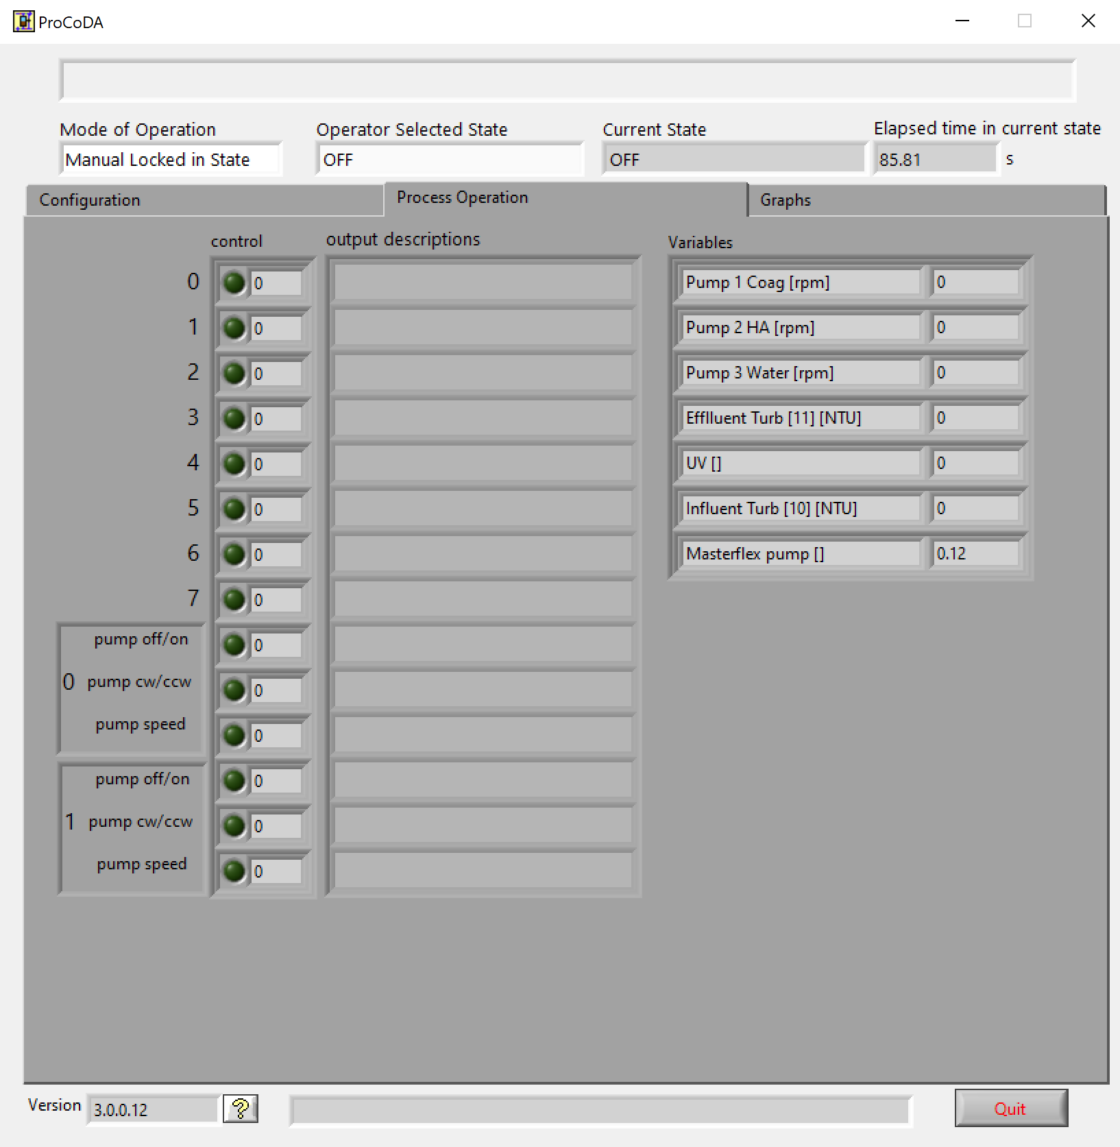
ProCoDa Method
Figure 1 (on left): List of Set points, their value and purpose for the Procoda Method
Figure 2 (middle): Image of Procoda set points in the rule editor
Figure 3 (on right): Image of the Procoda interface for the humic acid method
Humic Acid | Research | Final Presentation Spring 2021
Notes:
Kaleigh
Able to access the Procoda method for the humic acid testing
table of set points
went through set points and checked the requirements for the 3 pumps specifically and made sure that all matched data requirements
Think that with this saved method, the team will be able to successfully run lab trials and obtain data in a good time interval

Slide 9
Completed Tasks: Highlights
Reviewed ProCoDA code and past literature about humic acid
Met with our mentor, Tigran Mehrabyan and gained insight about next steps for Humic Acid Removal Subteam
Met with Monroe about Humic Acid Project and decided that the team should focus on varying Humic Acid Concentration
Redetermine the relationship between Humic Acid Concentration and Coagulant
Humic Acid | Research | Final Presentation Spring 2021
Notes:
For this semester, Humic Acid has accomplished a variety of tasks. First, at the start of the semester, the humic acid subteam analyzed past reports, procoda cost and previous problems the humic acid team faced. Additionally, we’ve had the opportunity to meet with our RIDE mentor Tigran. With him, we were able to ask questions about the current problems that people are having with humic acid and how we could target our research to solve those issues. With respect to starting in person research, with the assistance of Kevin Sarmiento, we were able to see the lab space in B55 in Hoilster and noted that the very first step would be to remodel the lab experimental setup previous years and determine what we would need in terms of materials to accomplish that. However, as we were unable to go into lab. this semester, we instead met with monroe on redefining what we should do for this semester and he noted that we should focus first on varying the concentration of humic acid and seeing how it affects coagulant dosage. With that said, he said we should also retest previous semester’s experiments and determine a better linear relationship as it should be an increasing relationship but not a decreasing one.

Slide 10
Completed Tasks: Highlights Continued
Developed a set of experimental trials with varying coagulant concentrations
Downloaded ProCoDA and defined the setpoints and explained what should be included for each run
Created a general procedure and list of required materials for experiments
Humic Acid | Research | Final Presentation Spring 2021
Notes:
Moving forward on this goal, using the python code were were able to determine a set of experimental trials that we could test at a future date. Through kaleigh’s download of procoda, we were able to view the method file and explain each set point and ensure that all the data matches were there. Finally, we created a brief general procedure and a list of materials that future humic acid subteam members could use in later experiements

Slide 11
Future Tasks for HA Subteam
Rebuild Experimental Setup and fix problems from previous semesters
Vary Parameters and determine optimum coagulant dosage
change pH, temperature and humic acid concentration
3. Automate trials through the use of ProCoDA
allow trials to run without us being present
Humic Acid | Research | Final Presentation Spring 2021
Notes:
For future tasks, the humic acid subteams should first focus on rebuilding the experimental setup and troubleshoot the problems from previous semesters. Another future task, after retesting humic acid concentrations, should be the changing of the pH and temperature and then see how that would affect the optimal coagulant dosage. Another is to automate ProCoDA, meaning develop a code that would allow us to run trials without us being present to start and stop the runs. This would allow us to collect more data and could save time for future humic acid removal subteams.

Slide 12
Appendix
Slides
Humic Acid| Research | Final Presentation Spring 2019
Notes:
From this point on, add any slides with figures that will help support your thesis. You might pull these figures from your Final Report.

Slide 13
Background
Natural Organic Matter: Present in surface and groundwater
Humic Acid
1) Color, taste and odor problems
2) Increased coagulant and disinfectant doses needed for removal
3) Biological growth in distribution system
4) Increased levels of complexed heavy metals and adsorbed organic pollutants
5) Increased levels due to climate change and human activity
Reacts with chlorine during chlorination - harmful effects
Figure 1: Diagram of the formation/ life of dissolved organic material
Humic Acid | Research | Final Presentation Spring 2021
Notes:
-Maya
Natural Organic Matter (NOM): Present in surface and groundwater. Within Natural Organic Matter, Dissolved Organic Matter (DOM) is a part of NOM that results from plant and animal decay. Humic acid constitutes a large fraction of DOM. and although they are beneficial to plants because of their stimulation of plant growth and increase of plant disease resistance, they are not beneficial for the drinking water treatment process.
Humic acid has a negative effect on water quality by causing colour, taste and odor problems, increased coagulant and disinfectant doses needed for removal (which in turn results in increased sludge volumes and production of harmful disinfection by-products), biological growth in distribution system, and increased levels of complexed heavy metals and adsorbed organic pollutants.
react with the chlorine to produce trihalomethanes and haloacetic acids, which have carcinogenic effects

Slide 14
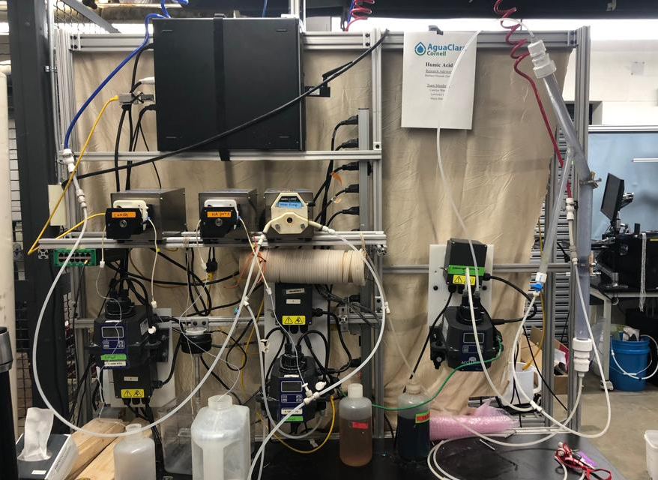
Experimental Design
Water in
Wastewater out
Recirculator
Coagulant pump
Water pump
Humic acid pump
Flocculator
Turbidimeter
Spectrophotometer
Figure 2: Image of lab set-up and experimental design
Humic Acid | Research | Final Presentation Spring 2021
Notes:
-Maya
Three pumps: one for coagulant, HA, and water
Water is pumped from the inlet and combined with the HA, then goes into the turbidimeter
Then combines with coagulant stream and goes into the flocculator, then into the recirculator and sedimentation tank and then the spectrophotometer
Flocs go into the tube settler, then combine with the stream out of the spectrophotomer to go to the wastewater stream out

Slide 15
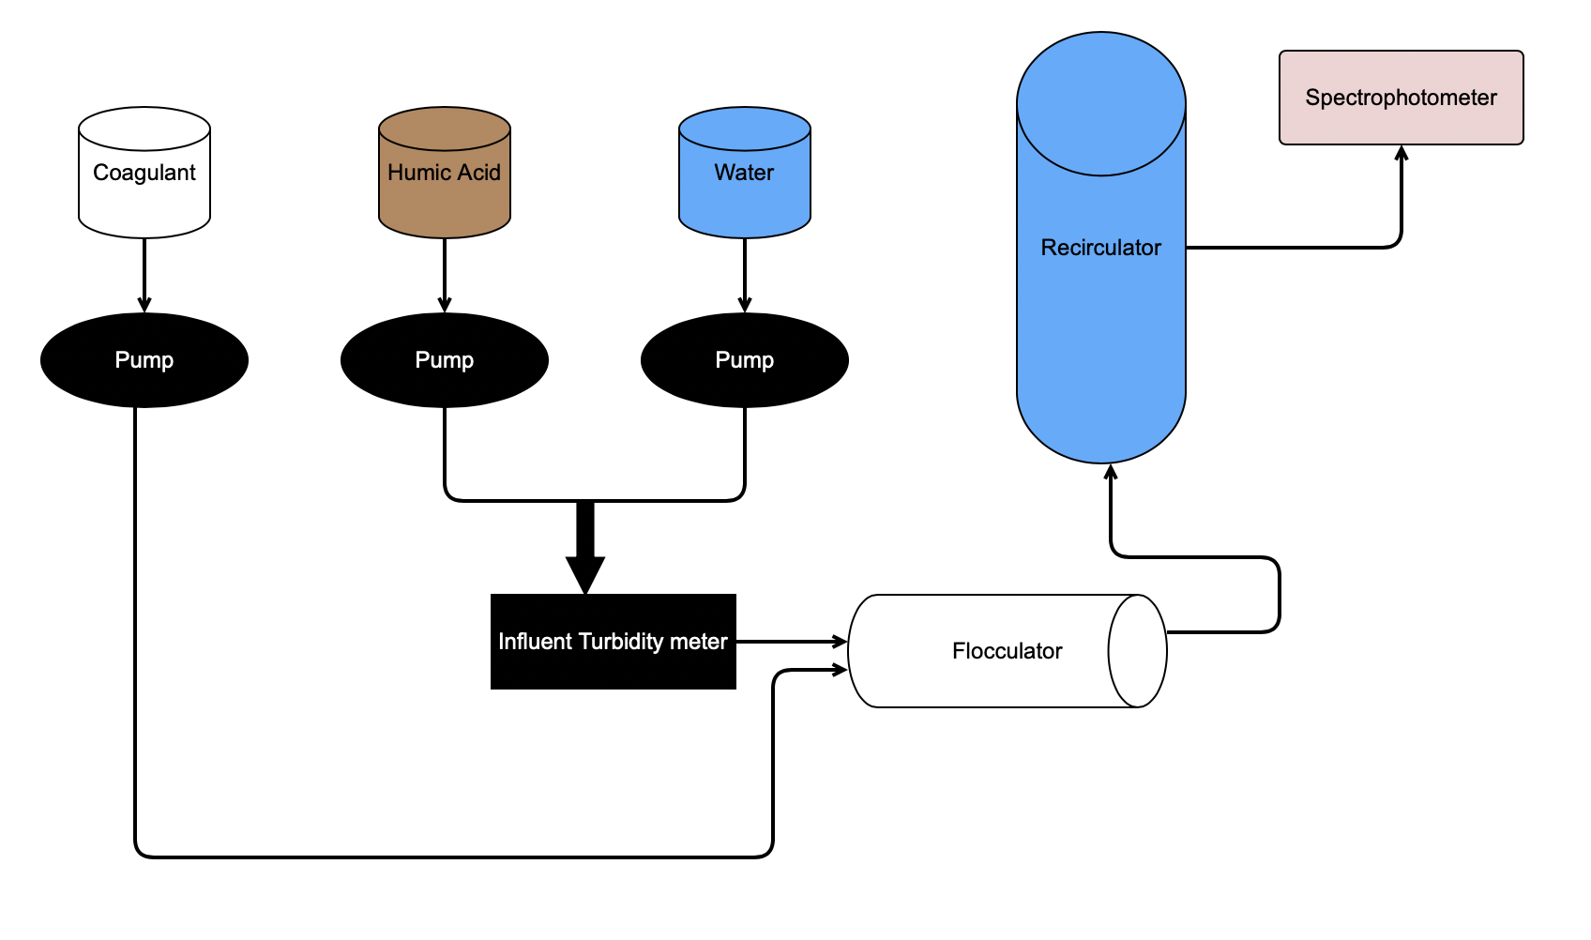
Schematic Drawing
Effluent Turbidity meter
Figure 3: Schematic drawing of the experimental set up for testing varying humic acid and coagulant concentrations
Humic Acid | Research | Final Presentation Spring 2021
Notes:
Maya

Slide 16
Bibliography
Logan, B. E., Hermanowicz, S. W., & Parker,A. S. (1987). A Fundamental Model for Trickling Filter Process Design. Journal (Water Pollution Control Federation), 59(12), 1029–1042.
Matilaninen, A, Vepsalainen, M & Sillanpaa, M. (2010). Natural Organic Matter Removal by Coagulation during Drinking Water Treatment. Adv Colloid Interface Sci.
Soh, YC, Roddick, F & Van Leeuwen, J. (2008). The Impact of Alum Coagulation on the Character, Biodegradability and Disinfection By-product Formation Potential of Reservoir Natural Organic Matter (NOM) Fractions. Water Sci Technol. 58(6), 1173-9.
Kopfler, F., H. Ringhand, W. Coleman, AND J. Meier. REACTIONS OF CHLORINE IN DRINKING WATER, WITH HUMIC ACIDS AND 'IN VIVO'. U.S. Environmental Protection Agency, Washington, D.C., EPA/600/D-84/196 (NTIS PB85160737).
Du, Y. (2017). Observations and a Geometric Explanation of the Effects of Humic Acid on Flocculation.
Humic Acid| Research | Final Presentation Spring 2019
Notes:
-Carolyn

Slide 17
Questions
and
Recommendations
Malini Balachandran // mvb37@cornell.edu
Kaleigh Soucy // krs258@cornell.edu
Joseph Nocua // jsn74@cornell.edu
Humic Acid | Research | Final Presentation Spring 2021

